Slide 1

Android application development for processing the output data of computer vision and machine learning techniques for segmentation of geometrical primitives on RGB images
Interdisciplinary Project
20.09.2018
Presented by
Juan Du
Bilal Ahmed

Slide 2

Introduction
Task Flow
User-Centered
Product
Algorithm
Interface
Q&A

Slide 3

Introduction
KEWAZO: Smart robotic scaffolding transportation
system
Problem
Solution

Slide 4
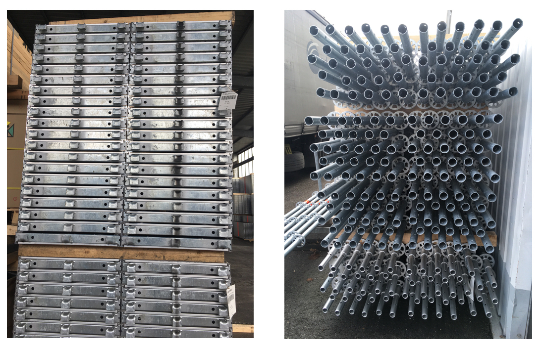
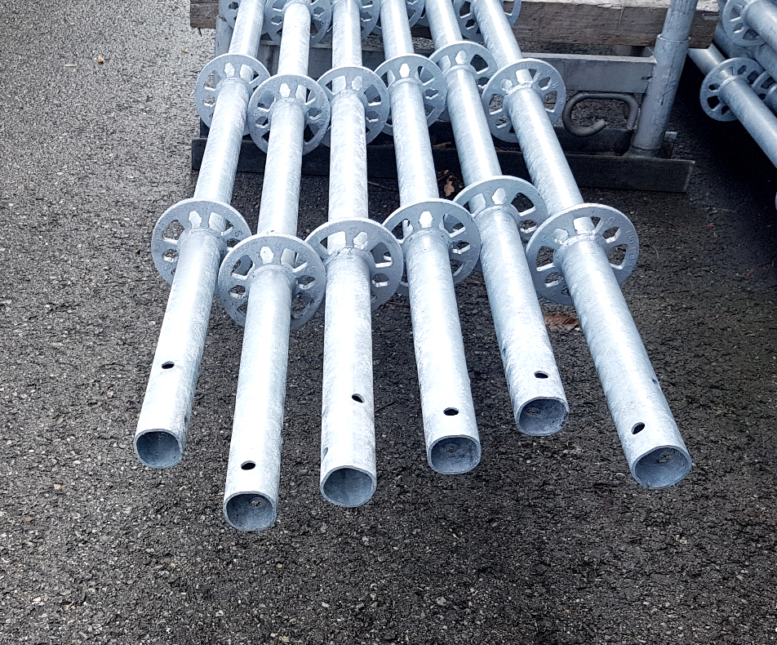
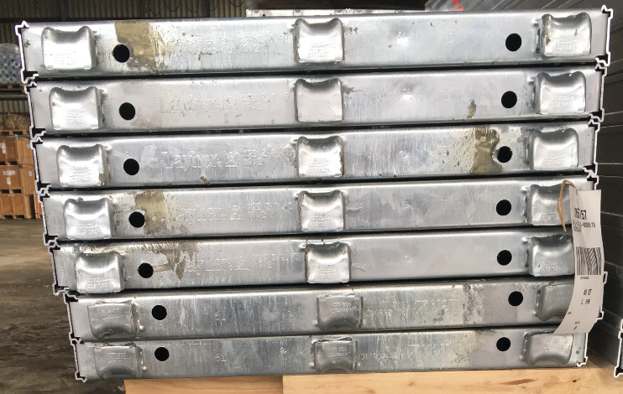

Problem
During the preparation, it is important to know the number and type of scaffolding parts located in the storage space

Slide 5
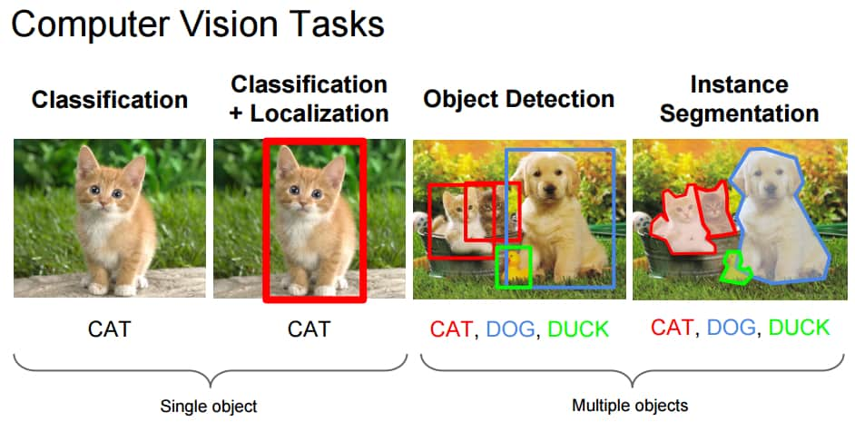

Solution
Computer Vision
Fast development, efficient
Smartphone Application
Computing power, convenient

Slide 6

User-Centered Design
Development proceeds with the user as the center of focus
Increase product usefulness and usability
Interface
Task Flow
Algorithm

Slide 7
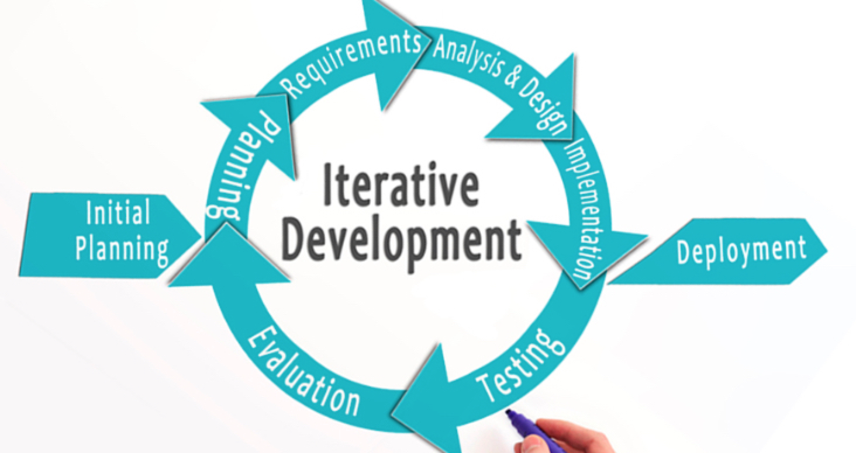
Task Flow: Iterative Model
Adaptable to the ever changing needs
Frequent user feedback

Slide 8
User-Centered Design
Development proceeds with the user as the center of focus
Increase product usefulness and usability
Interface
Task Flow
Algorithm

Slide 9

CV Algorithm
The most suitable algorithm
Core Requirements ?
Accuracy
Speed
Dataset Feature?
Extreme Environments?

Slide 10
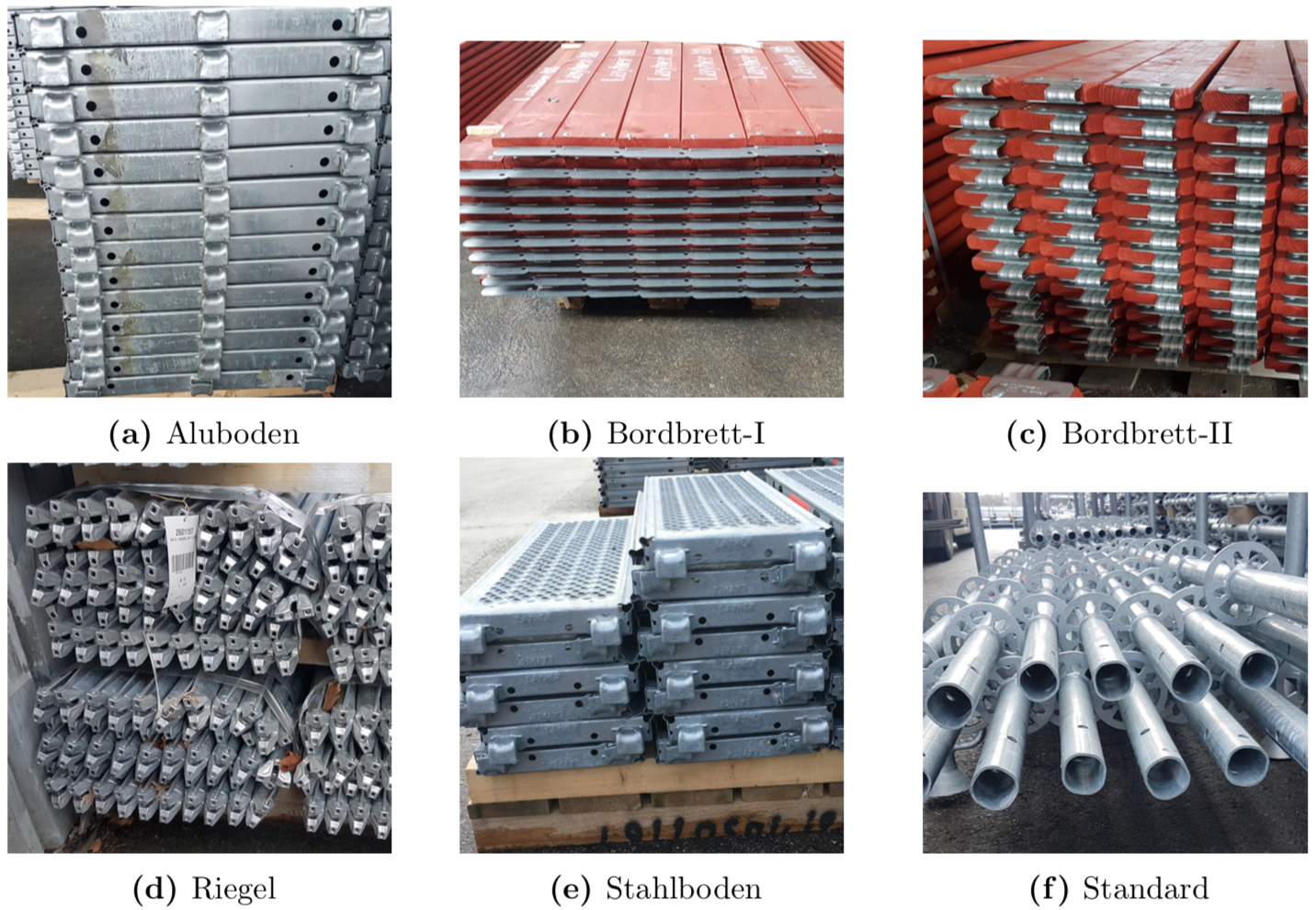
Dataset
Generality : Apply the same algorithm for multiple types of objects

Slide 11
CV Algorithm
The most suitable algorithm
Core Requirements ?
Accuracy
Speed
Dataset Feature?
Generality
Extreme Environments?

Slide 12
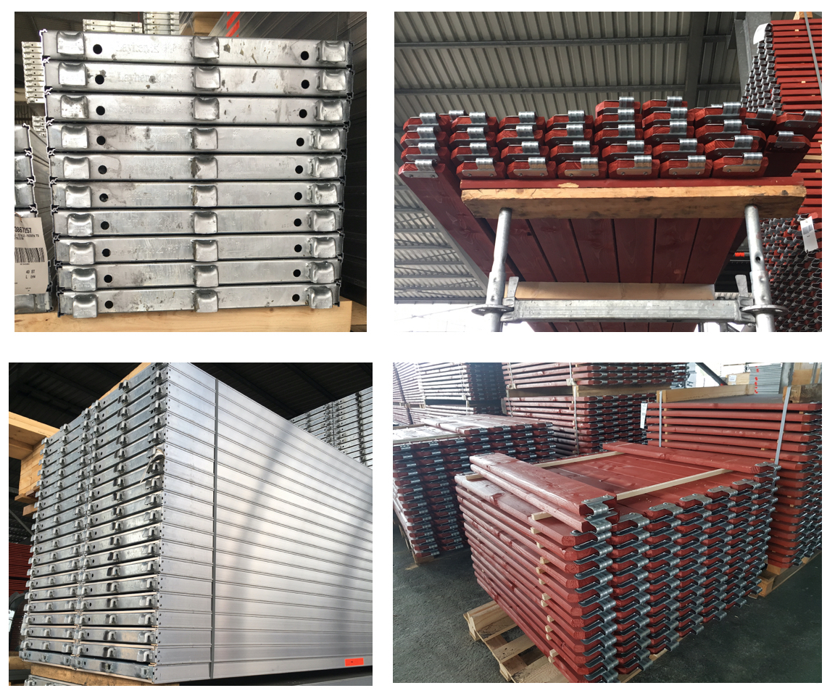
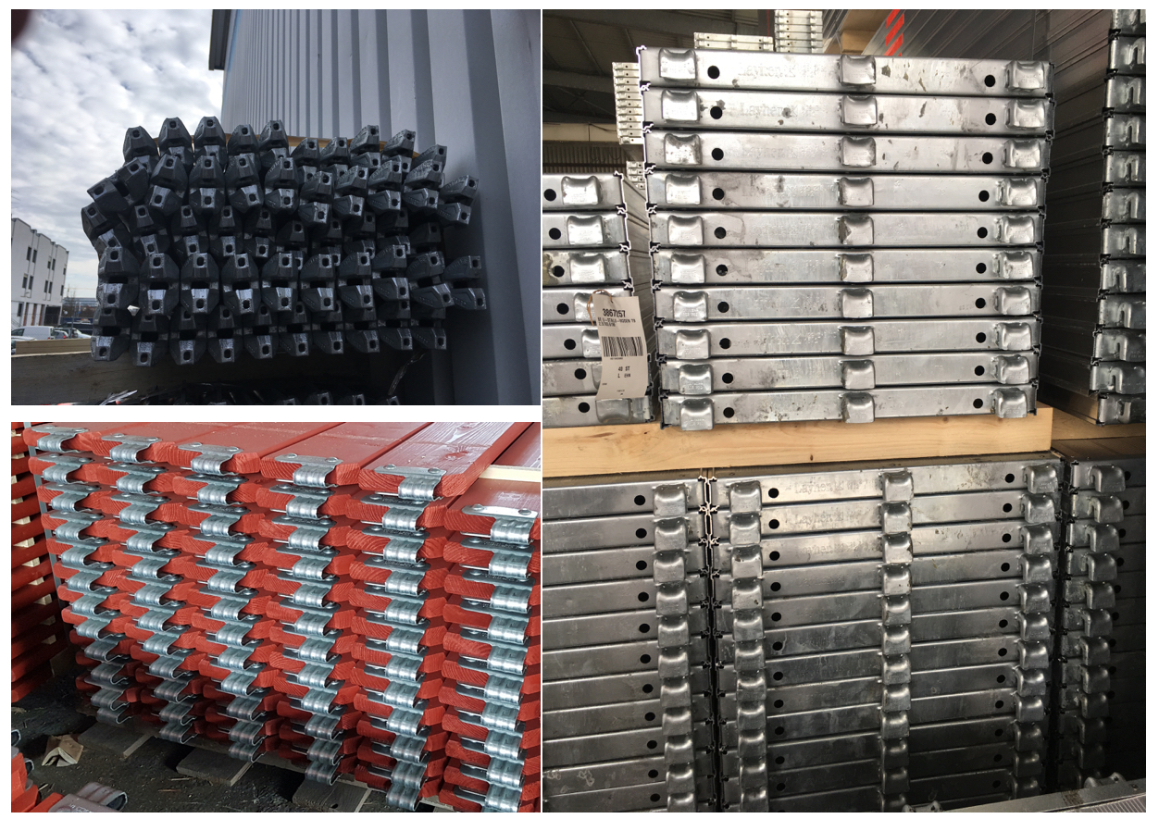
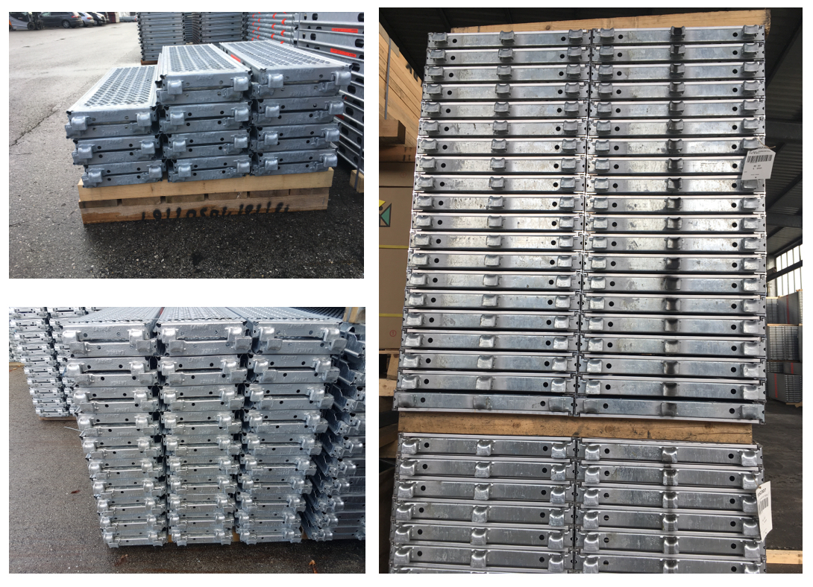
Extreme Environments
Robustness
Viewpoint
Light
Quantity

Slide 13
CV Algorithm
The most suitable algorithm
Core Requirements ?
Accuracy
Speed
Dataset Feature?
Generality
Extreme Environments?
Robustness

Slide 14
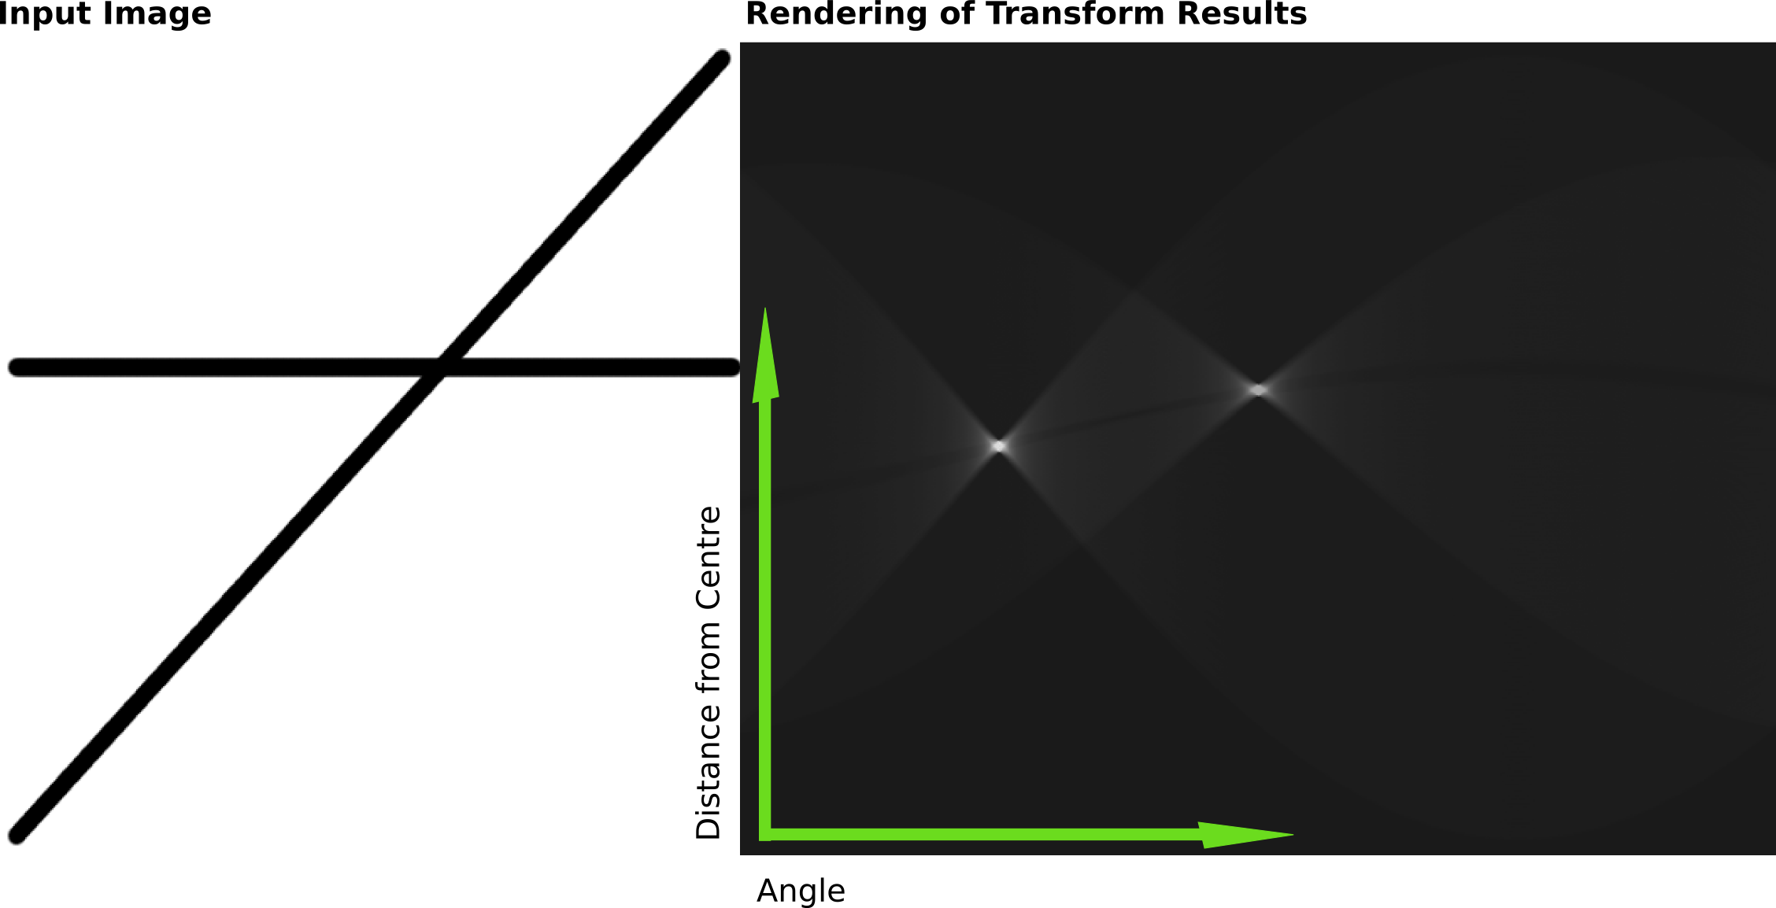
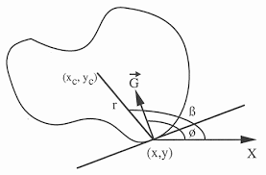
CV Algorithm
Generalized Hough Transform (GHT)
Fast
Arbitrary shapes
Robust
Pre-process and Post-process
More accurate
Robust

Slide 15
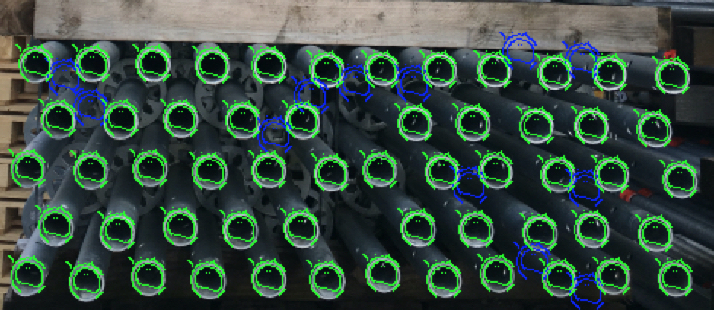
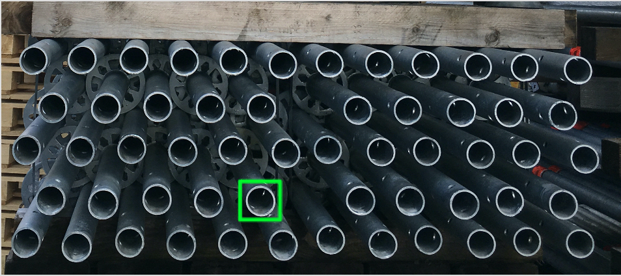
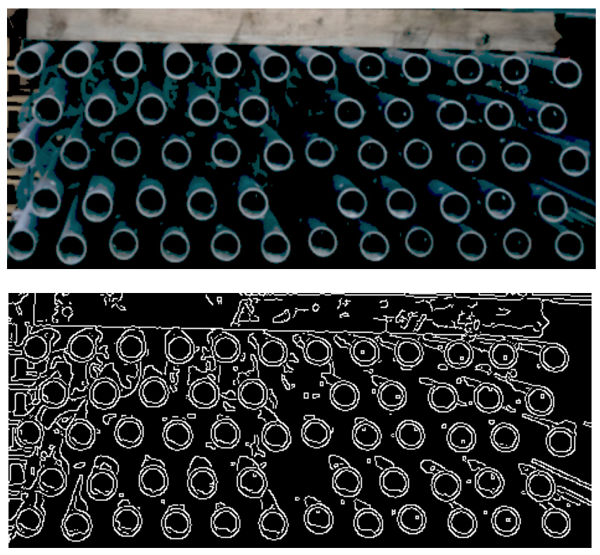
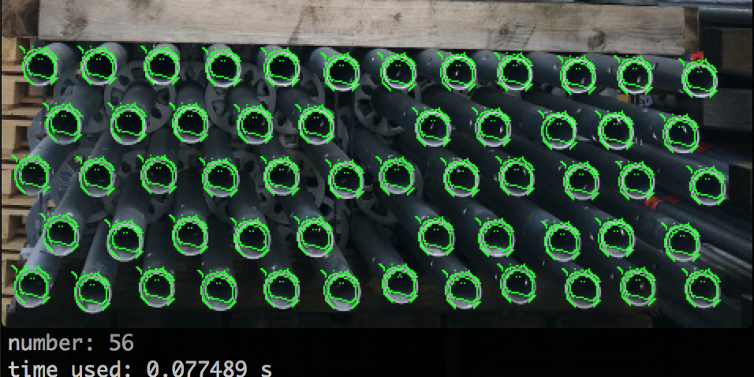

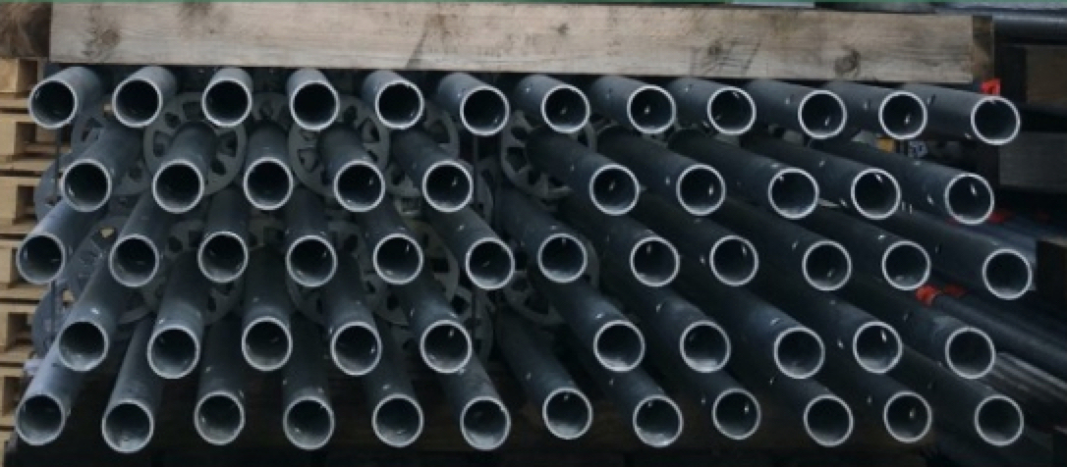
CV Algorithm: Overall Process
Input image
Choose template
Pre-process
Apply GHT algorithm
Post-process
Final result

Slide 16
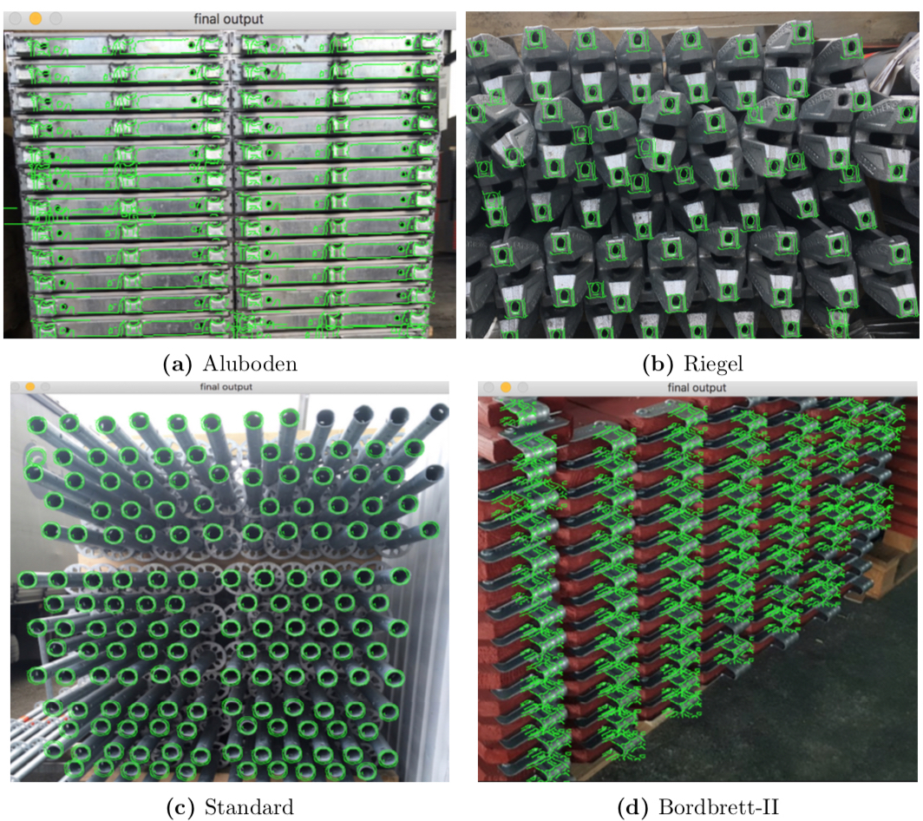
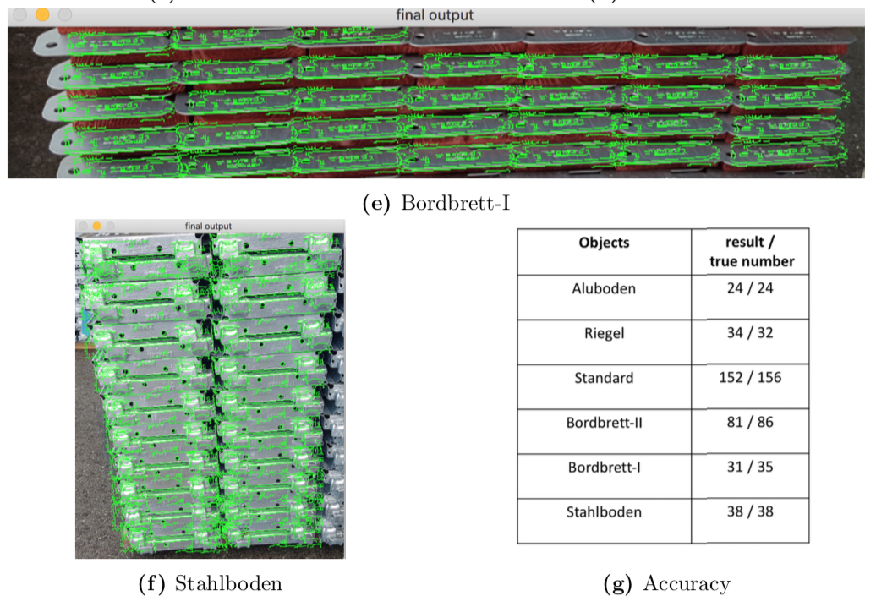
CV Algorithm: More Results

Slide 17
User-Centered Design
Development proceeds with the user as the center of focus
Increase product usefulness and usability
Interface
Task Flow
Algorithm

Slide 18
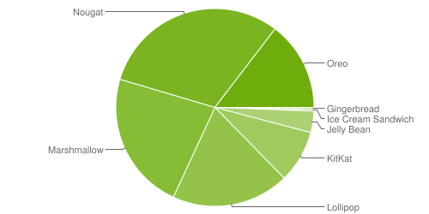
Mobile App
Our CV algorithm should be implemented in an app
Android or iOS?
What do our clients use?
Which version of Android?
Maximum market share

Slide 19
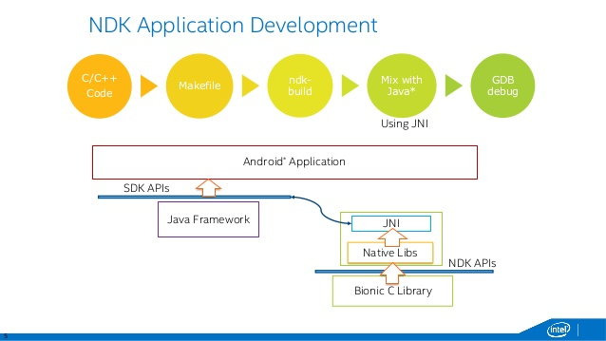
JNI Framework (Java Native Interface)
CV algorithm written in C++
C++ is a speedy language
Performance constraints
Android apps written in Java
Incompatible
JNI functions written to bridge
the gap

Slide 20
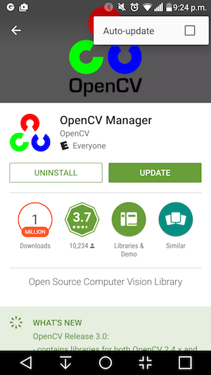
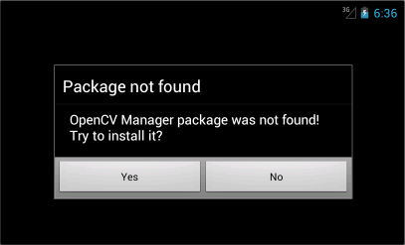
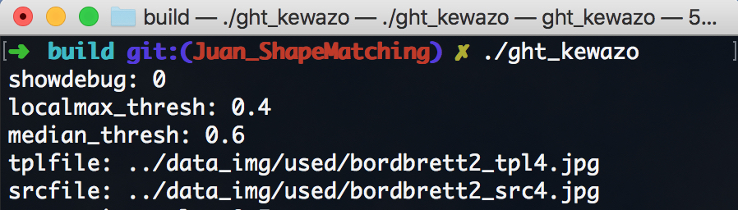
Making intuitive app
Goal to make user friendly app
Algorithm requires user inputs through command line
Algorithm requires dependencies to be installed
Solutions?

Slide 21
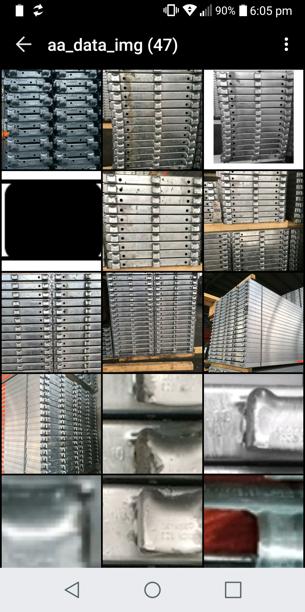
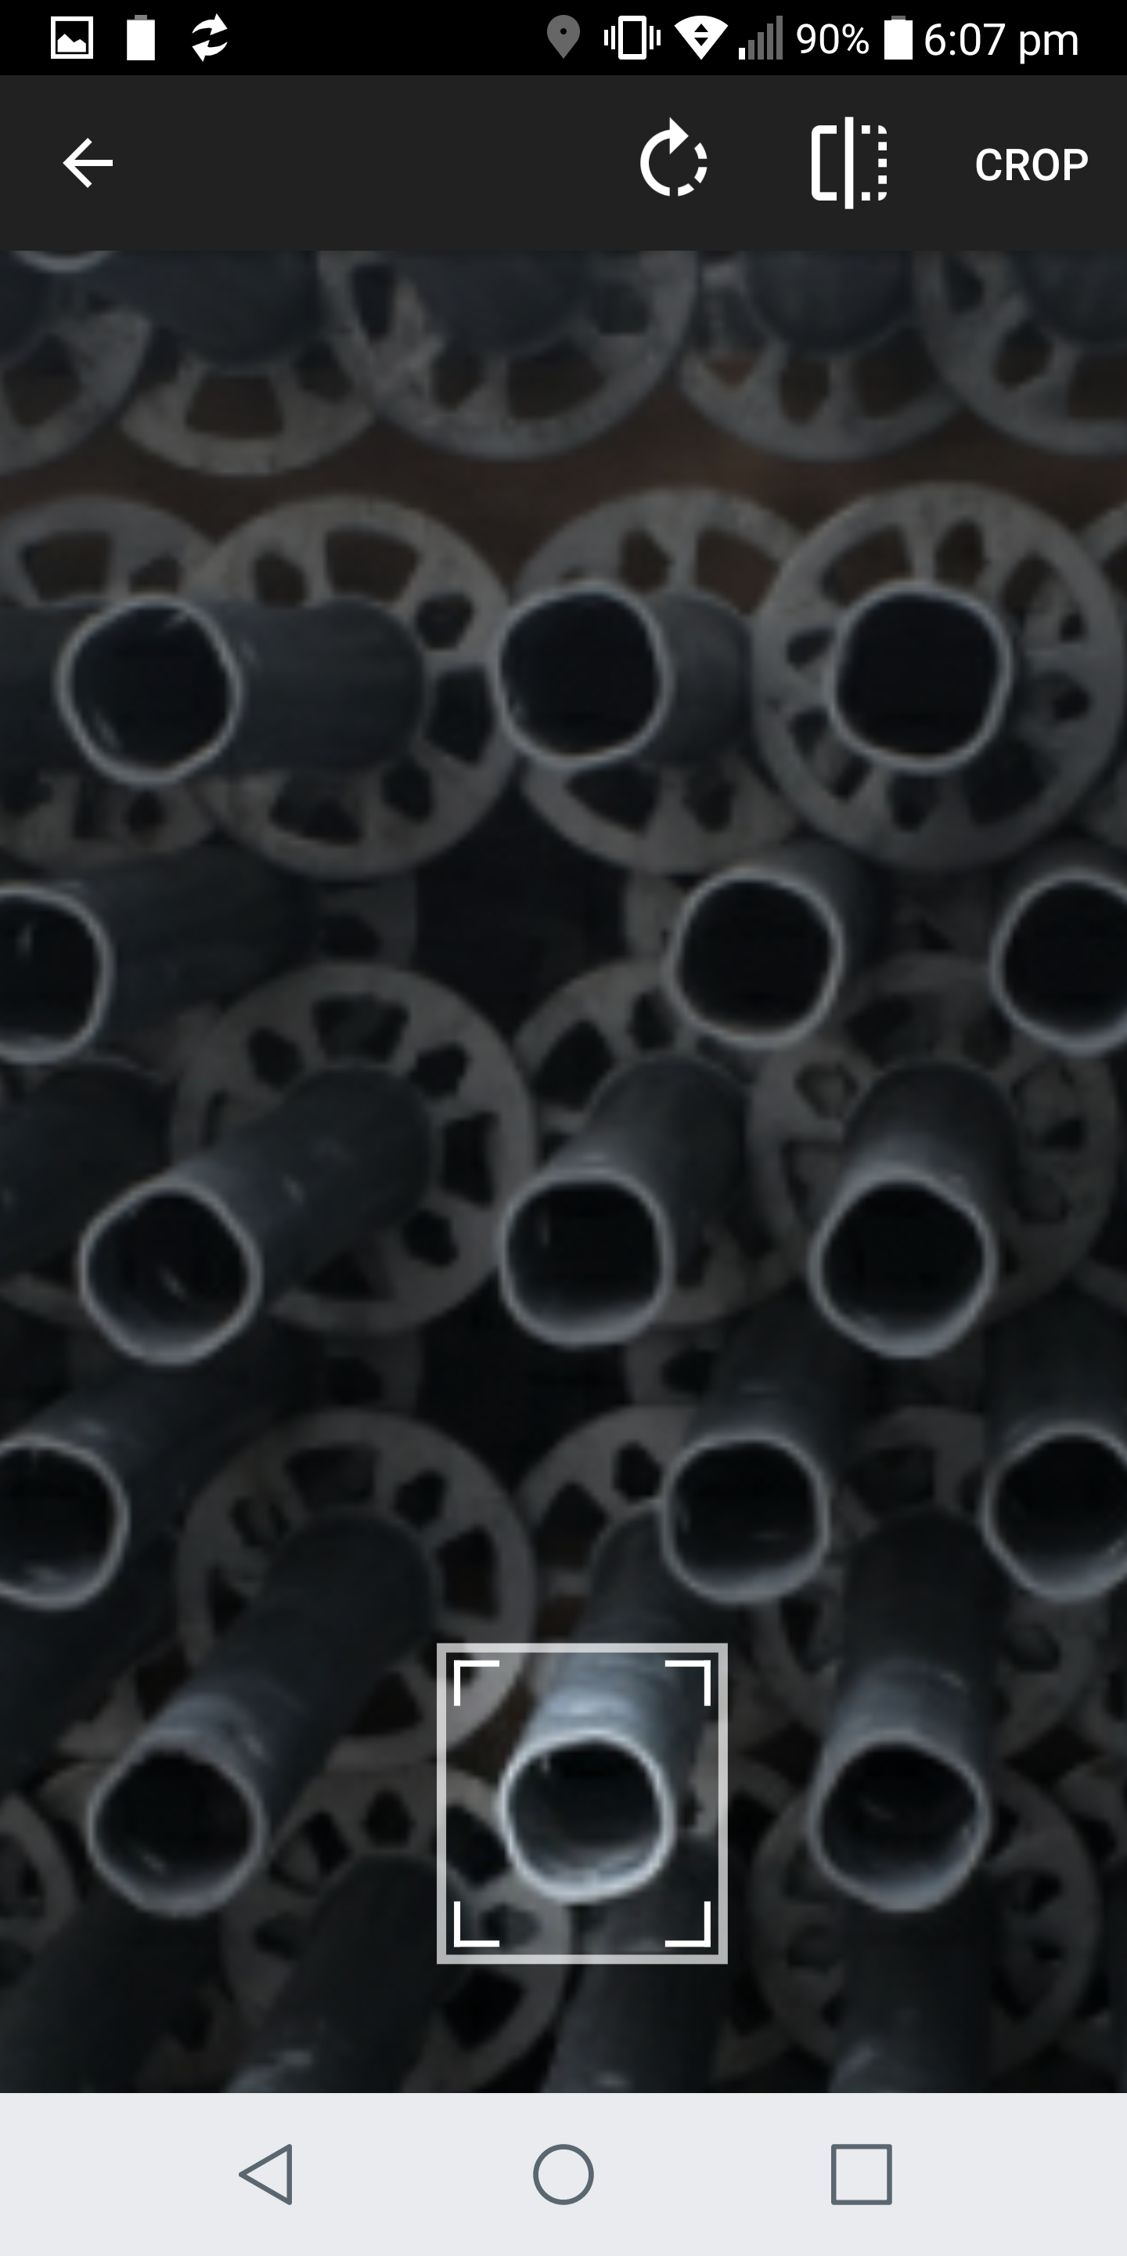

Solutions
User can select source through gallery/camera
Upon selection, user has to crop to get a template
Algorithm requires CV libraries
Package dependencies inside application, prevent additional steps

Slide 22
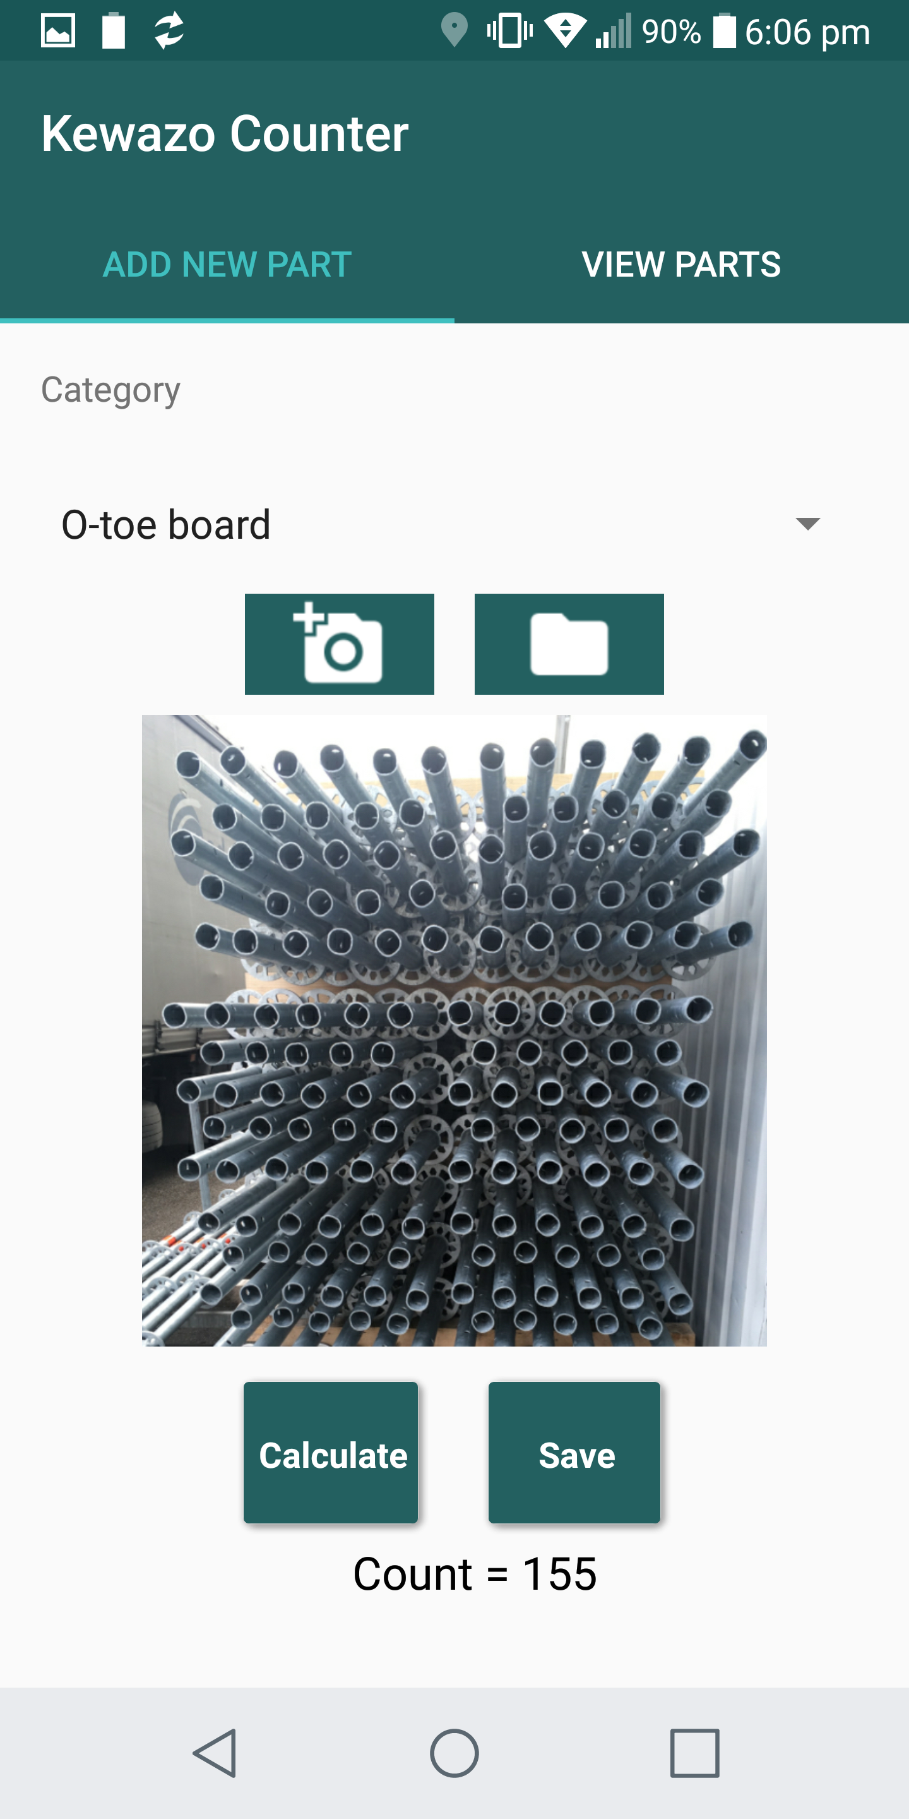
Results
No need to install any external app
User gets results in minimum clicks/taps

Slide 23
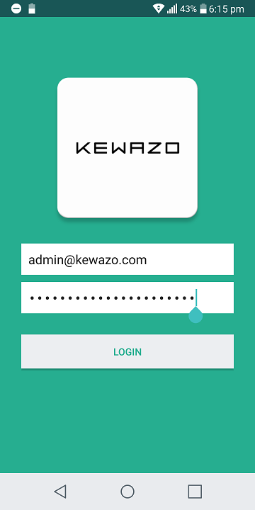
Prevent Unauthorized Usage
Login functionality implemented at startup
Authenticates with the KEWAZO Server

Slide 24
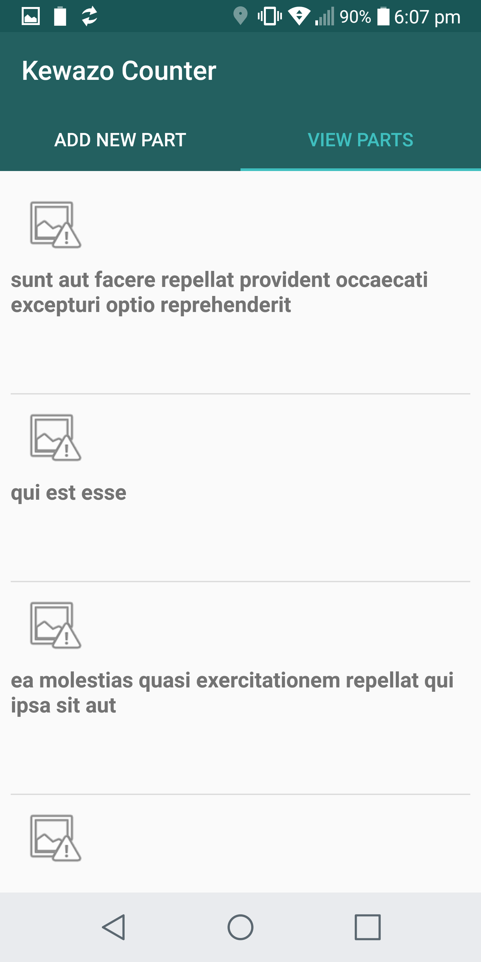
After Results – Future App Work
Algorithm results
We want to store data
Available data
User id : kewazo@gmail.com
Image
Item Category : O toe steel rods
Item count : 35
Location
Date
Store and retrieve data to/from a server

Slide 25
Future Algorithm Work
Recognize the template automatically
Use more Machine Learning techniques with larger dataset
Real-time image recognition without taking a source

Slide 26
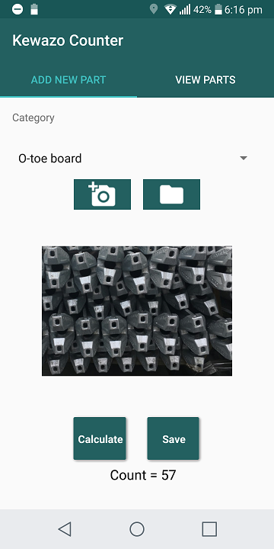
Q&A

